Slide 1
Ecosystem of Hadoop
Science research in UIT lab

Slide 2
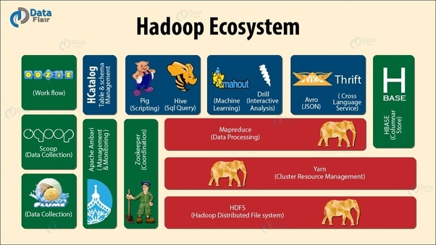
Chapter summary:
Avro
Spark
Hbase
Hive
ZooKeeper
Storm

Slide 3

Apache Avro:
Apache Avro is a language-neutral data serialization system. Having a data format that can be processed by many languages (currently C, C++, C#, Java, JavaScript, Perl, PHP, Python, and Ruby).
Devising to address the major downside of Hadoop Writables : lack of language portability.
Easy to share datasets with a wider audience than one tied to a single language.
It is also more future-proof, allowing data to potentially outlive the language used to read and write it.

Slide 4
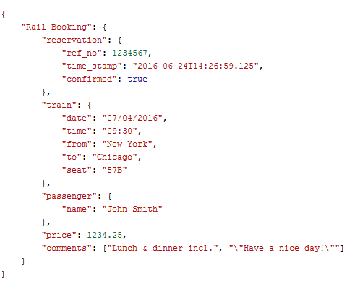
Apache Avro:
Comparison of JSON and Avro:
JSON Biggest Drawback :
Data has no Schema Enforcing

Slide 5
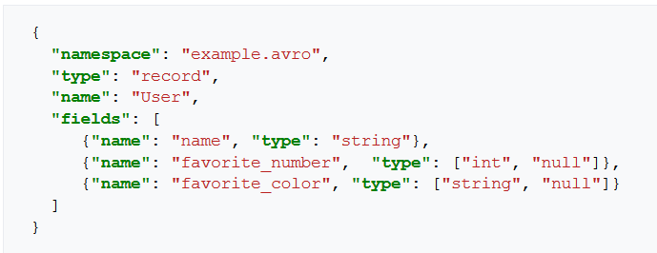
Apache Avro:
Comparison of JSON and Avro:
Avro :
Data is fully typed.
Schema comes along with data.
Data can be read across any language.
Schema can evolve over time.

Slide 6

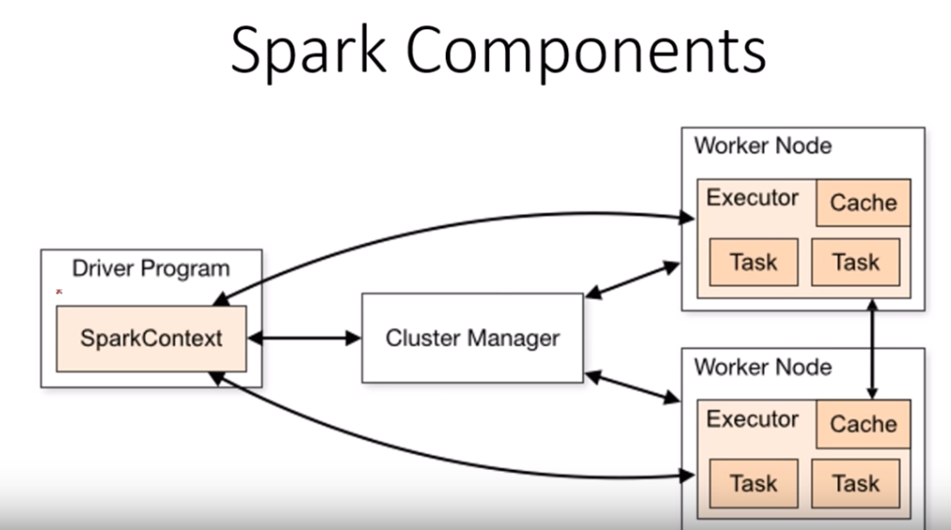
Apache spark:
Apache Spark is a cluster computing framework for large-scale data processing.
Spark does not use MapReduce as an execution engine; instead, it uses its own distributed runtime for executing work on a cluster.
Spark is closely integrated with Hadoop.

Slide 7
Apache spark: Advantage
Spark is best known for its ability to keep large working datasets in memory between jobs.
This capability allows Spark to outperform the equivalent MapReduce workflow ,where datasets are always loaded from disk. (Run programs up to 100x faster than Hadoop MapReduce in memory, or 10x faster on disk. )
Two styles of application that benefit greatly from Spark’s processing model:
Iterative algorithms (where a function is applied to a dataset repeatedly until an exit condition is met).
Interactive analysis (where a user issues a series of ad hoc exploratory queries on a dataset).

Slide 8
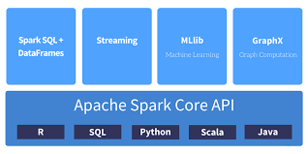
Apache spark: Generality
At the time of writing, Spark provides APIs in five languages: Scala, Java, and Python, R and SQL.
Spark is proving to be a good platform on which to build analytics tools.
the Apache Spark project includes modules for machine learning (MLlib), graph processing (GraphX), stream processing (Spark Streaming), and SQL (Spark SQL).

Slide 9

Hbase:
HBase is a distributed column-oriented database built on top of HDFS. HBase is the Hadoop application to use when you require real-time read/write random access to very large datasets.
Unlike relational database systems, HBase does not support a structured query language like SQL; in fact, HBase isn’t a relational data store at all.
HBase does support writing applications in Apache Avro, REST, and Thrift.

Slide 10
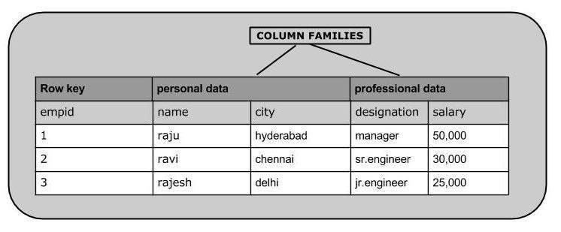
Hbase:
An HBase system comprises a set of tables. Each table contains rows and columns, much like a traditional database. Each table must have an element defined as a Primary Key, and all access attempts to HBase tables must use this Primary Key. Besides that, collection of columns will involve in group called column family.
Avro, as a component, supports a rich set of primitive data types including: numeric, binary data and strings; and a number of complex types including arrays, maps, enumerations and records. A sort order can also be defined for the data.

Slide 11
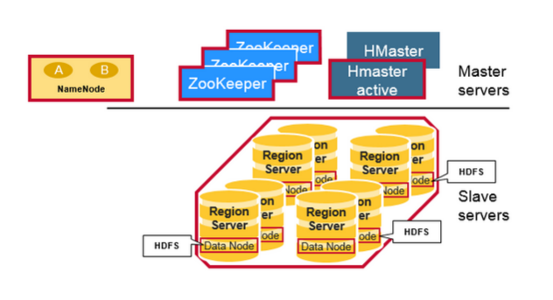
Hbase:
Hbase structure has 3 primary components:
Hmaster:
Region assignment.
DDL operations (Create , delete and update tables).
Zookeeper:
Storage of metadata and region info.
Hregion Server:
Monitoring and storing regions which it has responsibility to.
When receiving a write/read request from client, it will assign request for particular regions contain column family.

Slide 12
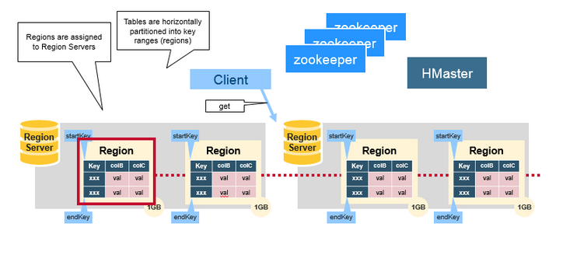
Hbase:
Region:
HBase Tables are divided horizontally by row key range into “Regions.”
A region contains all rows in the table between the region’s start key and end key.
Regions are assigned to the nodes in the cluster, called “Region Servers,” and these serve data for reads and writes.
A region server can serve about 1,000 regions.
Region has 2 components ,namely memstore and Hfile.

Slide 13
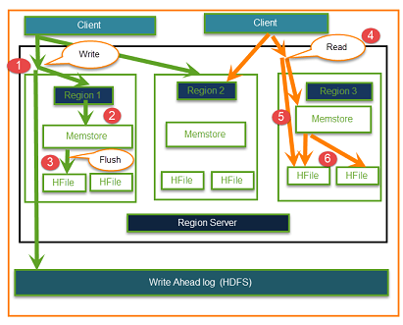
Hbase:
Write operations:
Step 1: Client creates a first connection with Regions server and then regions. Step 2: Regions contacts with memstore, storing connection with column family.
Step 3: Data will store firstly in Memstore where data is sorted before passing to HFile.
2 reasons for the existence of HFile:
Sorting is the core factor of distributed store system base on row key.
Data flow optimizing when using the Log-Structured Merge Tree.

Slide 14

Apache Hive:
The Apache Hive ™ data warehouse software facilitates reading, writing, and managing large datasets residing in distributed storage using SQL. Structure can be projected onto data already in storage.
While initially developed by Facebook, Apache Hive is used and developed by other companies such as Netflix.
Apache Hive provide following functions:
Data Summarization
Query
Analysis

Slide 15
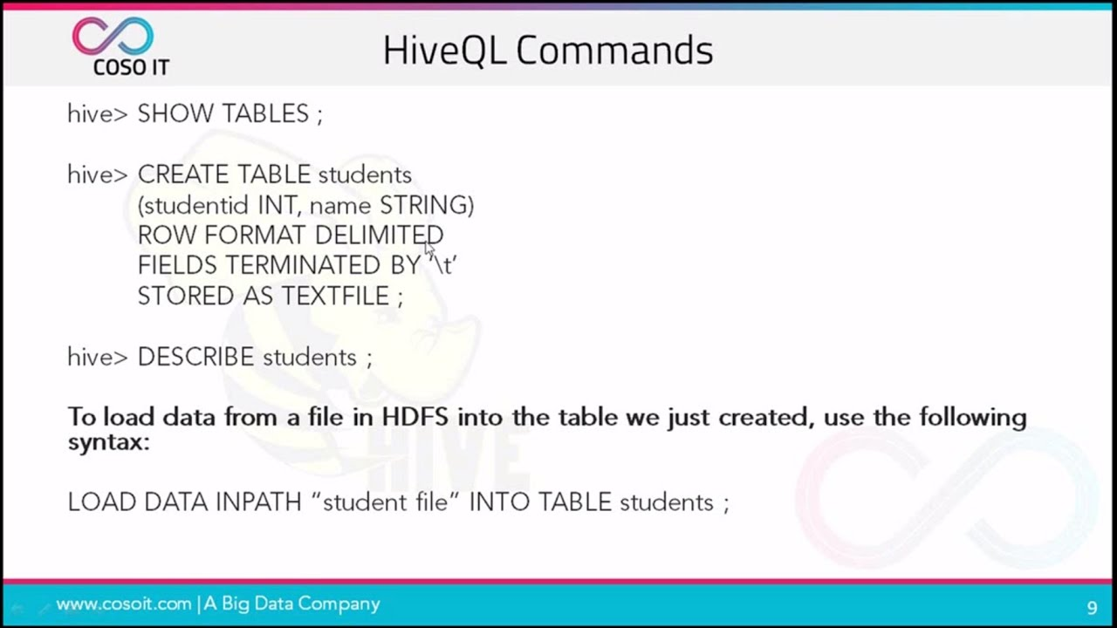
Apache Hive:
The Apache Hive ™ uses HiveQL to the query data without knowledge of Java or MapReduce.
HiveQL provides Indexing which assists to search for a particular record, Instead of searching all the records.

Slide 16
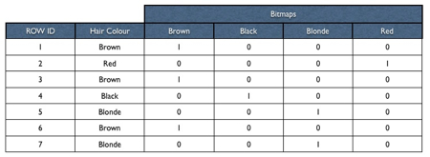
Apache Hive:
Indexing in HiveQl also includes special database index - bitmap indexes

